Slide 1
Fun with Big Data
Big Data Pipeline with Hadoop/HDFS, Spark, Dremio, Jypter Notebook, Tablaeu

Slide 2
Hypothetical Problem Statement
A company has 10 million positions on 20,000 tradeable instruments.
Company has separate risk system datasets: Credit Risk, Market Risk and Interest Rate Risk on these positions. Every Risk dataset is massive as well.
Challenge is how do we build a system that can process datasets with massive scale? A system that can store massive amount of data, can run arbitrary analytics, can support Business Intelligence, flexible Reports etc.

Slide 3
Objectives are to Demo
Pipeline of large Risk data sets
Data Lakes of source system data
Positions, Instruments, Counterparties, Books
Credit Risk, Interest Rate Risk, Volatility Risks
Query, Analytics and Aggregation of Data Lake
BI Tools and Visual Aspects
Micro-services
SQL Operations
Power of Docker (Containerization)
Most importantly – Have Fun ☺ [This entire product was built in 3 days]

Slide 4
Tech Stack that I am using
Python 3.6
Docker (containerization)
Hadoop HDFS (File system storage)
Parquet (file format)
Python Micro services (Apache arrow) write source system data to HDFS
Dremio to query HDFS
Tableau (with Dremio as a source) as BI Tool to analyze HDFS data
Spark environment
PySpark / Spark SQL to run analytics
Jupyter Notebook to share queries and ad hoc reports
Everything installed and configured on my Linux VM’s

Slide 5
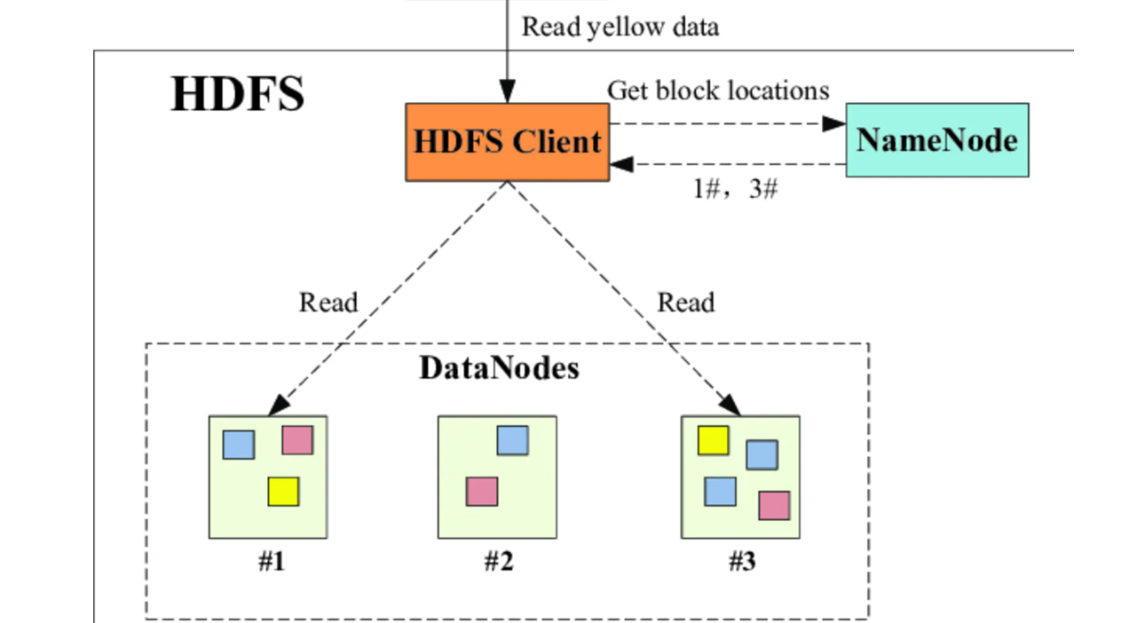
Let’s start – Install Hadoop HDFS
Docker Images https://github.com/rshah2019/docker-hadoop-rshah
/home/svc-portal-uat/docker-hadoop/datanode# docker ps
CONTAINER ID IMAGE COMMAND CREATED STATUS PORTS NAMES
9d90d0ee95da bde2020/hadoop-datanode:2.0.0-hadoop3.2.1-java8 "/entrypoint.sh /run…" 4 days ago Up 4 days (healthy) datanode
37f58e6788cc bde2020/hadoop-resourcemanager:2.0.0-hadoop3.2.1-java8 "/entrypoint.sh /run…" 4 days ago Up 4 days (healthy) resourcemanager
78938b4d8cb4 bde2020/hadoop-namenode:2.0.0-hadoop3.2.1-java8 "/entrypoint.sh /run…" 4 days ago Up 4 days (healthy) namenode
d7ad5be23eab bde2020/hadoop-historyserver:2.0.0-hadoop3.2.1-java8 "/entrypoint.sh /run…" 4 days ago Up 4 days (healthy) historyserver
9f2f4c225379 bde2020/hadoop-nodemanager:2.0.0-hadoop3.2.1-java8 "/entrypoint.sh /run…" 4 days ago Up 10 minutes (healthy) nodemanager
Components:
DataNodes
Resource Manager
NameNode
History Server
Node Manager

Slide 6
Now let’s write data to HDFS
Some data taken from online open data sets, such as list of currencies, issuers, tickers, brokers, counterparties.
Most of other data produced using random string/number.
Counterparty
Counterparty ID,
Name, Code, etc.
Interest Rate Risk
Position ID, IR Measure1, 2, 3,..
Books
Book ID, Portfolio, PM,
Business, Region etc.
Positions
Position ID
AsofDate/RecordTime
Book ID
Product ID
Counterparty ID
Quantity/Exposure
Credit Risk
Position ID,
CreditMeasure1, 2, 3,..
Instruments
Product ID, Ticker, ISIN,
Issuer, Maturity,
Currency, et.
Volatility Risk
Position ID,
Vol Measure1, 2, 3,..

Slide 7
Data Sizes
Data Type | Rows | Columns
Positions | 10 Million | 8
Instruments | 8000 | 11
Books (Portfolios) | 12 | 5
Counterparties | 81 | 3
Credit Risk | 10 Million | 30
Interest Rate Risk | 10 Million | 30
Volatility Risk | 10 Million | 30
For purpose of this Demo, we will only focus on single bi-temporal data set for
COB / As of Date: 05-29-2020 (month end EOD for May 2020)
Knowledge Time: 05-31-2020_17_18_UTC (time when all data sets produced)

Slide 8
Producers of the Data (Source systems)
https://github.com/rshah2019/DWH
Written in Python 3 using pandas and Apache pyarrow.
Each type of dataset is in-memory pandas dataframe written to HDFS as .parquet file.
Producers take 2 main inputs: 1) HDFS NameNode address. 2) Asof_date, knowledge time to derive HDFS directory being written
Portfolio Management Data ~ 7 minutes to produce and write
Risk Data (Credit, Rate, Vol Risks) ~ 15 minutes to produce and write

Slide 9
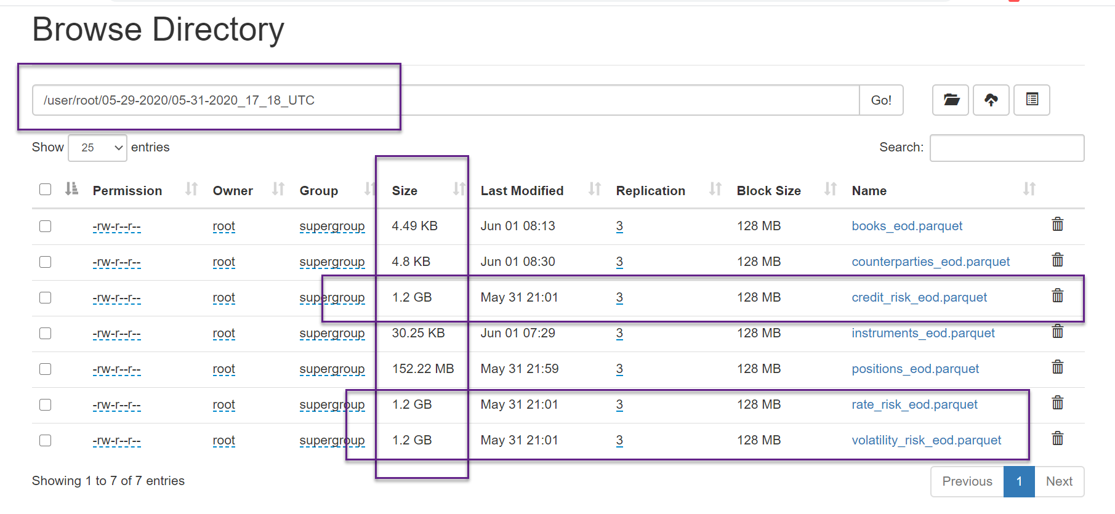
HDFS File browser

Slide 10
How do we view/query data ? Enter Dremio
Dremio: “discover, curate, accelerate, and share any data at any time, regardless of location, volume, or structure” – From its site
Setup Environment https://hub.docker.com/r/dremio/dremio-oss/
Components
Embedded Zookeeper
Master Coordinator
Executor
User Interface

Slide 11
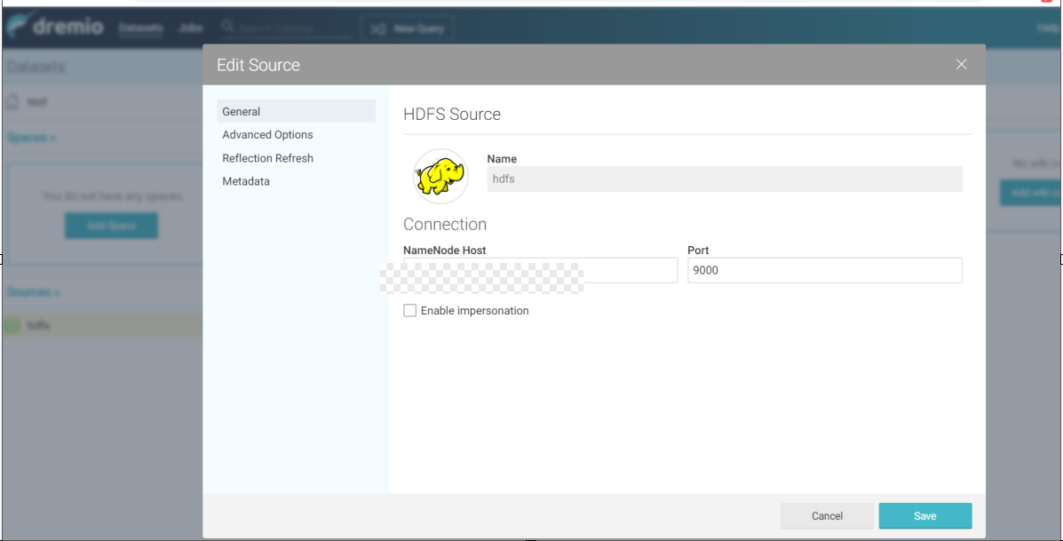
Dremio : 1st register HDFS NameNode source

Slide 12
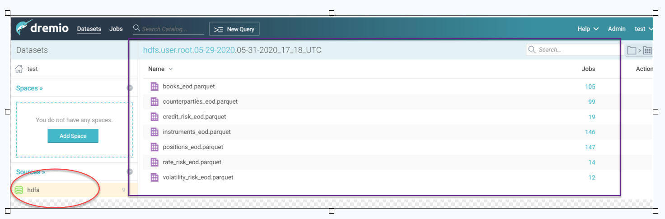
Dremio auto discovers HDFS files

Slide 13
Dremio – we can now write queries
“Volatility Risk 05-29-2020” :Create Custom DataSet from raw parquet files
Requirement: We want to view Volatility Risk measures for every position but we want to see associated tradeable instrument info, counteraparty info, books info, product info etc.
Solution: Join every dimension with Positions using good old SQL JOINS.
SELECT positions.PositionId, instruments.ProductId,AssetClass, Sector, Industry, ProductType, Currency, Maturity, Isin, Symbol, Issuer, books.BookId, Manager,BusinessUnit,Strategy,Region,CounterpartyId, CounterpartyCode, CounterpartyFullName, Quantity,Exposure, Volatility0Pct, Volatility1Pct, Volatility2Pct, Volatility3Pct, Volatility4Pct, Volatility5Pct
FROM "positions_eod.parquet" positions
join "instruments_eod.parquet" instruments ON positions.ProductId = instruments.ProductId
join "counterparties_eod.parquet" cp ON positions.CounterpartyId = cp.PartyId
join "books_eod.parquet" books ON positions.BookId = books.BookId
join "volatility_risk_eod.parquet" vol ON positions.PositionId = vol.PositionId

Slide 14
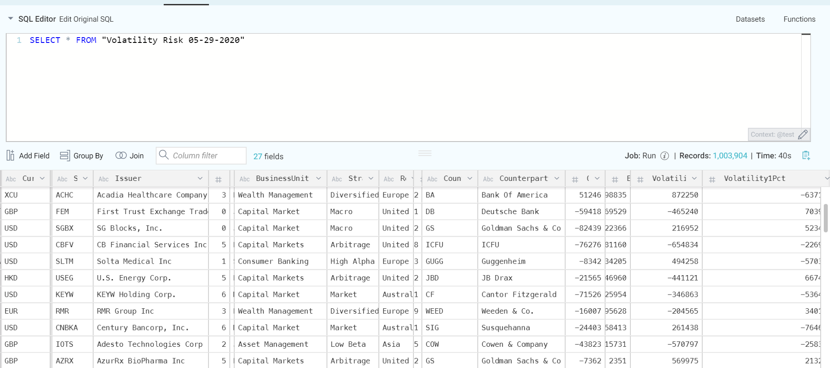
Dremio : Now you can query the custom data set created on previous page.

Slide 15
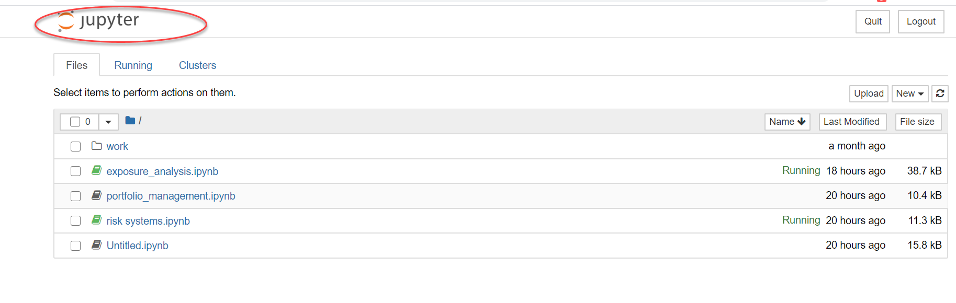
jupyter notebook
Web based code, visuals, charts sharing. Great for collaboration
Install https://hub.docker.com/r/jupyter/datascience-notebook/

Slide 16
Spark
Install https://github.com/big-data-europe/docker-spark
Configures one spark master and multiple workers
We are now ready to use Spark queries in jyupter notebook

Slide 17
PySpark : Let’s try to solve business problems
Query all positions trading on GBP Instruments
See Visual Plot of Exposures by Asset Class
See Visual Plot of Exposures by Currency
See distribution of Exposures

Slide 18
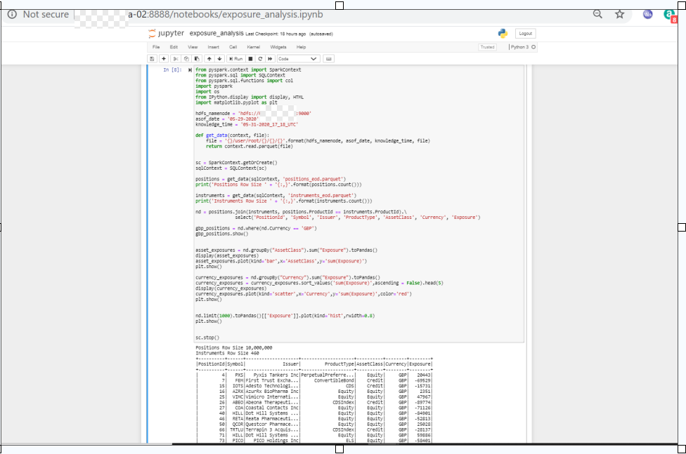
Fun with PySpark Data Frames (1)

Slide 19
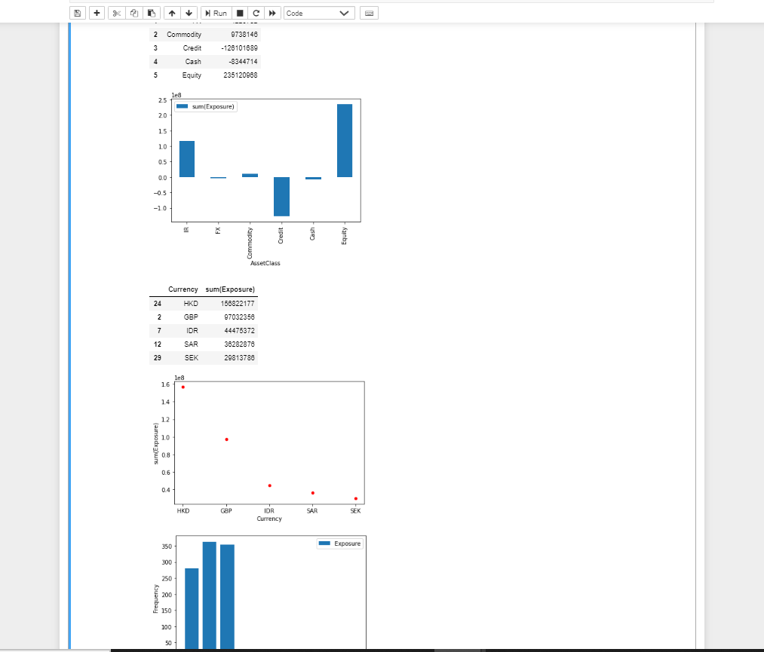
Fun with PySpark Data Frames (2)

Slide 20
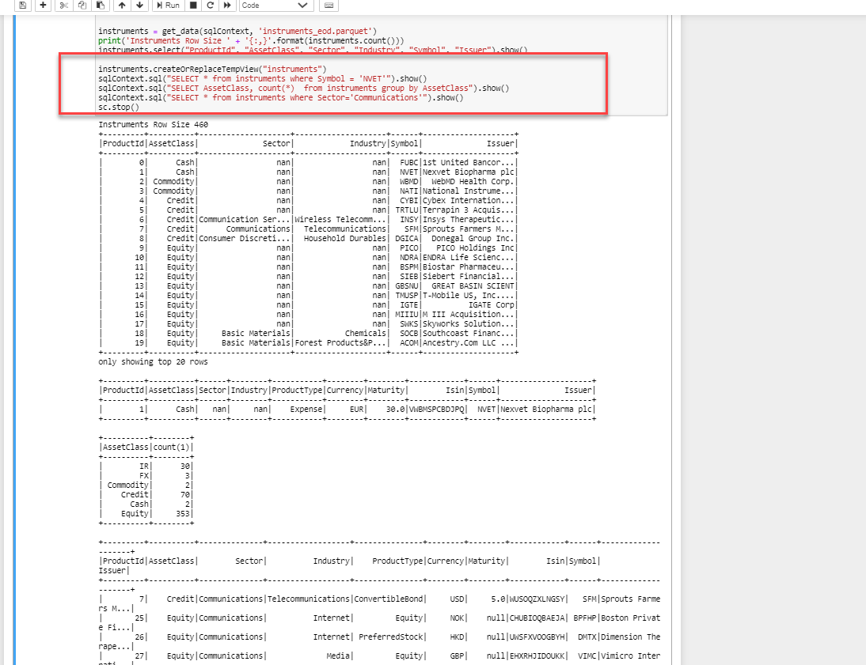
Spark SQL : write raw SQL queries

Slide 21
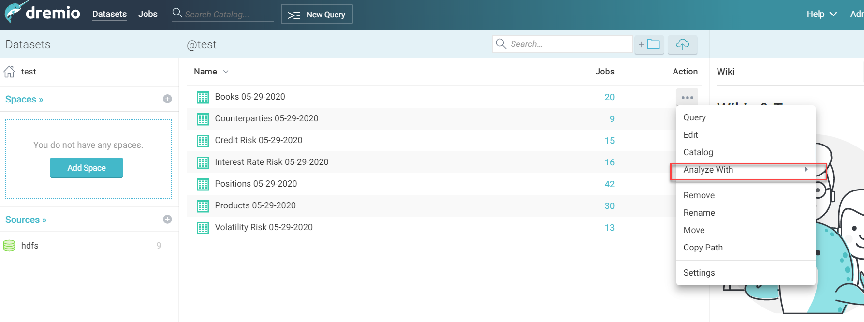
Tableau : BI Tool
For each Dremio Data definition, Analyze with “Tabeau”

Slide 22
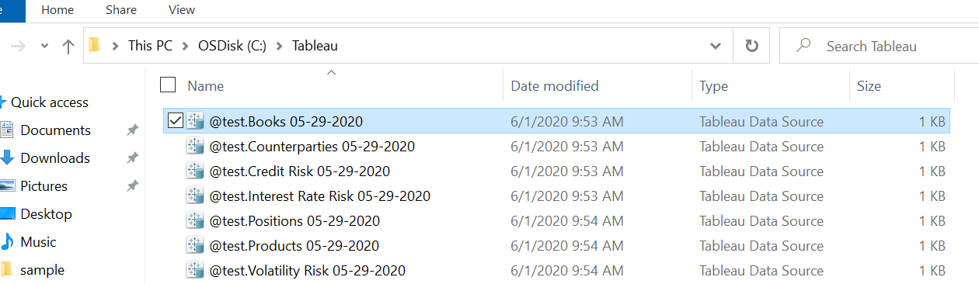
Tableau Data Source
That will produce Data Source definition file, not the actual Data Export
So now, pipe is Tableau -> Dremio -> Parquet File. All via LIVE data connection!

Slide 23
Tableau Data Source definition
<?xml version='1.0' encoding='utf-8'?><datasource inline="true" version=""><connection class="genericodbc" dbname="DREMIO" odbc-connect-string-extras="AUTHENTICATIONTYPE=Basic Authentication;CONNECTIONTYPE=Direct;HOST=<host-name>" odbc-dbms-name="Dremio" odbc-driver="Dremio Connector" odbc-dsn="" odbc-suppress-connection-pooling="" odbc-use-connection-pooling="" schema="&quot;@test&quot;" port="31010" server="" username=""><relation name="Books 05-29-2020" type="table" table="[@test].[Books 05-29-2020]"/></connection></datasource>

Slide 24
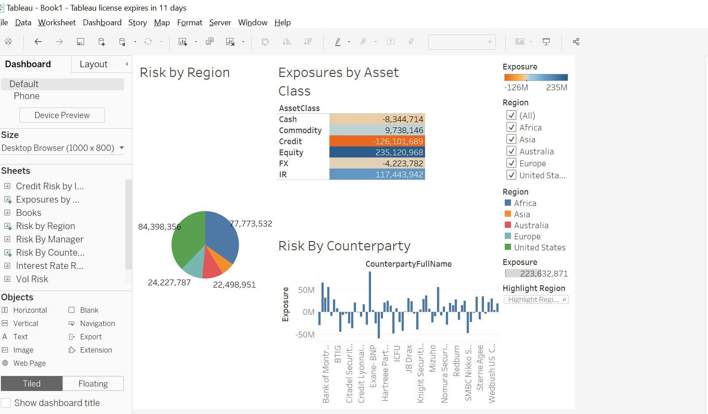

Slide 25
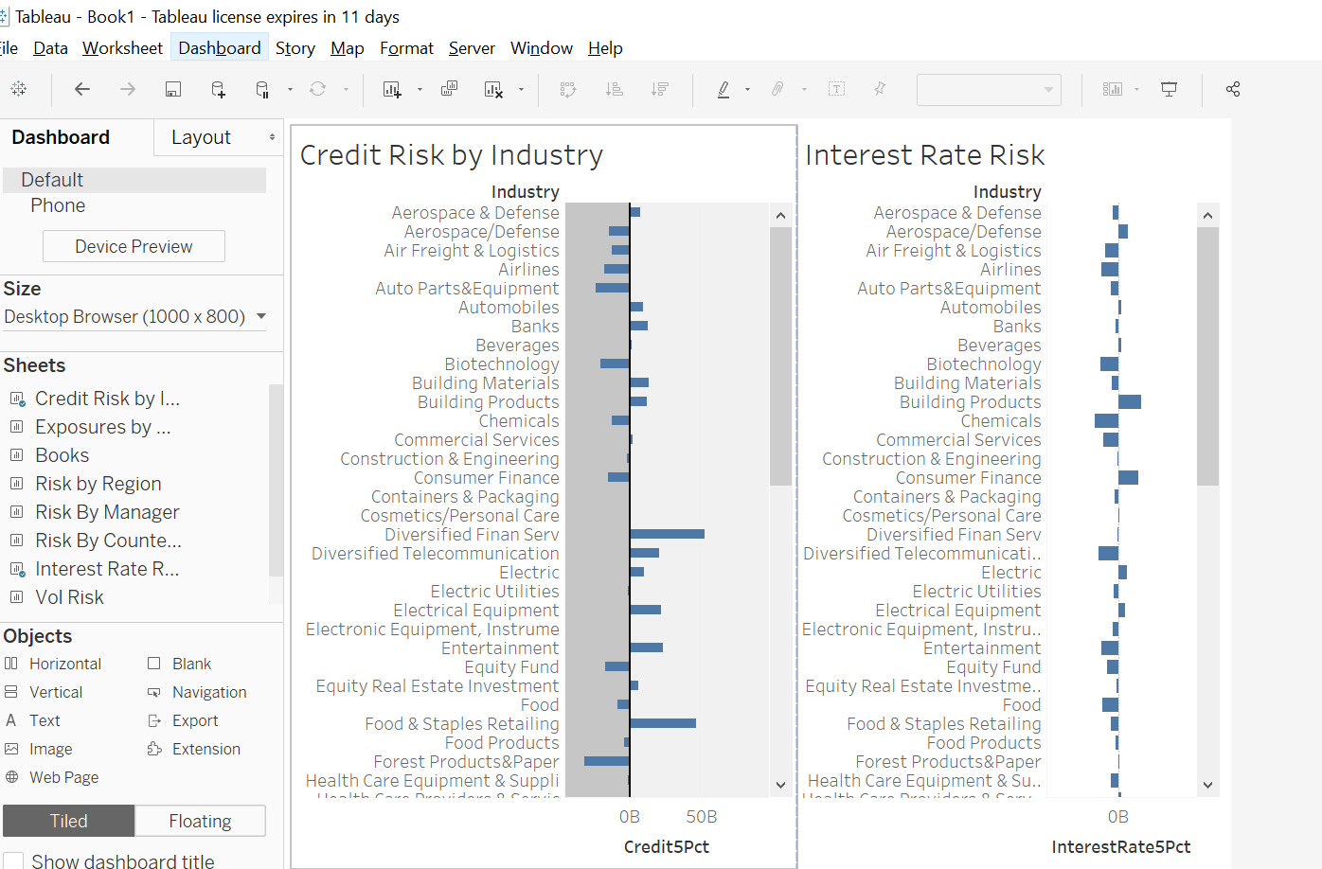

Slide 26
Micro-services with Flask and Django
Downstream reports
Downstream scenarios
Downstream calculators

